Slide 1
ITrade

Slide 2
Agenda
Introduction
Influence of AI on the stock Market
How Itrade works
Argumentaion
Final review & takeaways

Slide 3

What is Itrade?

Slide 4

Itrade
Online tool for trading stocks aimed at begginers

Slide 5
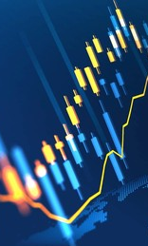
Itrade is for beginners
ITRADE is a project developed by Mykhailo Varha, a university student at VU Amsterdam. It recommends stocks, from many different industries, to a user based on the stocks performance in the market .
The user additionally can input a year – which will filter all the stocks younger than that year out. They can also select to look at only the top % of the stocks or based on how well the stock is rated on Environmental, Social and Goveranance aspects.

Slide 6

AI in the stock market

Slide 7
Is Ai good for the market?
The answer to this question is yes. AI does many good things for the market, from enhancing security, for example Black Rock does this, to an algorythmic trading approach like Kavout or MLQ.ai
The algorythmic trading also causes the market operation to be processed much faster, which causes liquidity of the market to rise.
The benefits of a liquid stock market:
Lower risk
High accesibility
Low entry and exit barriers

Slide 8
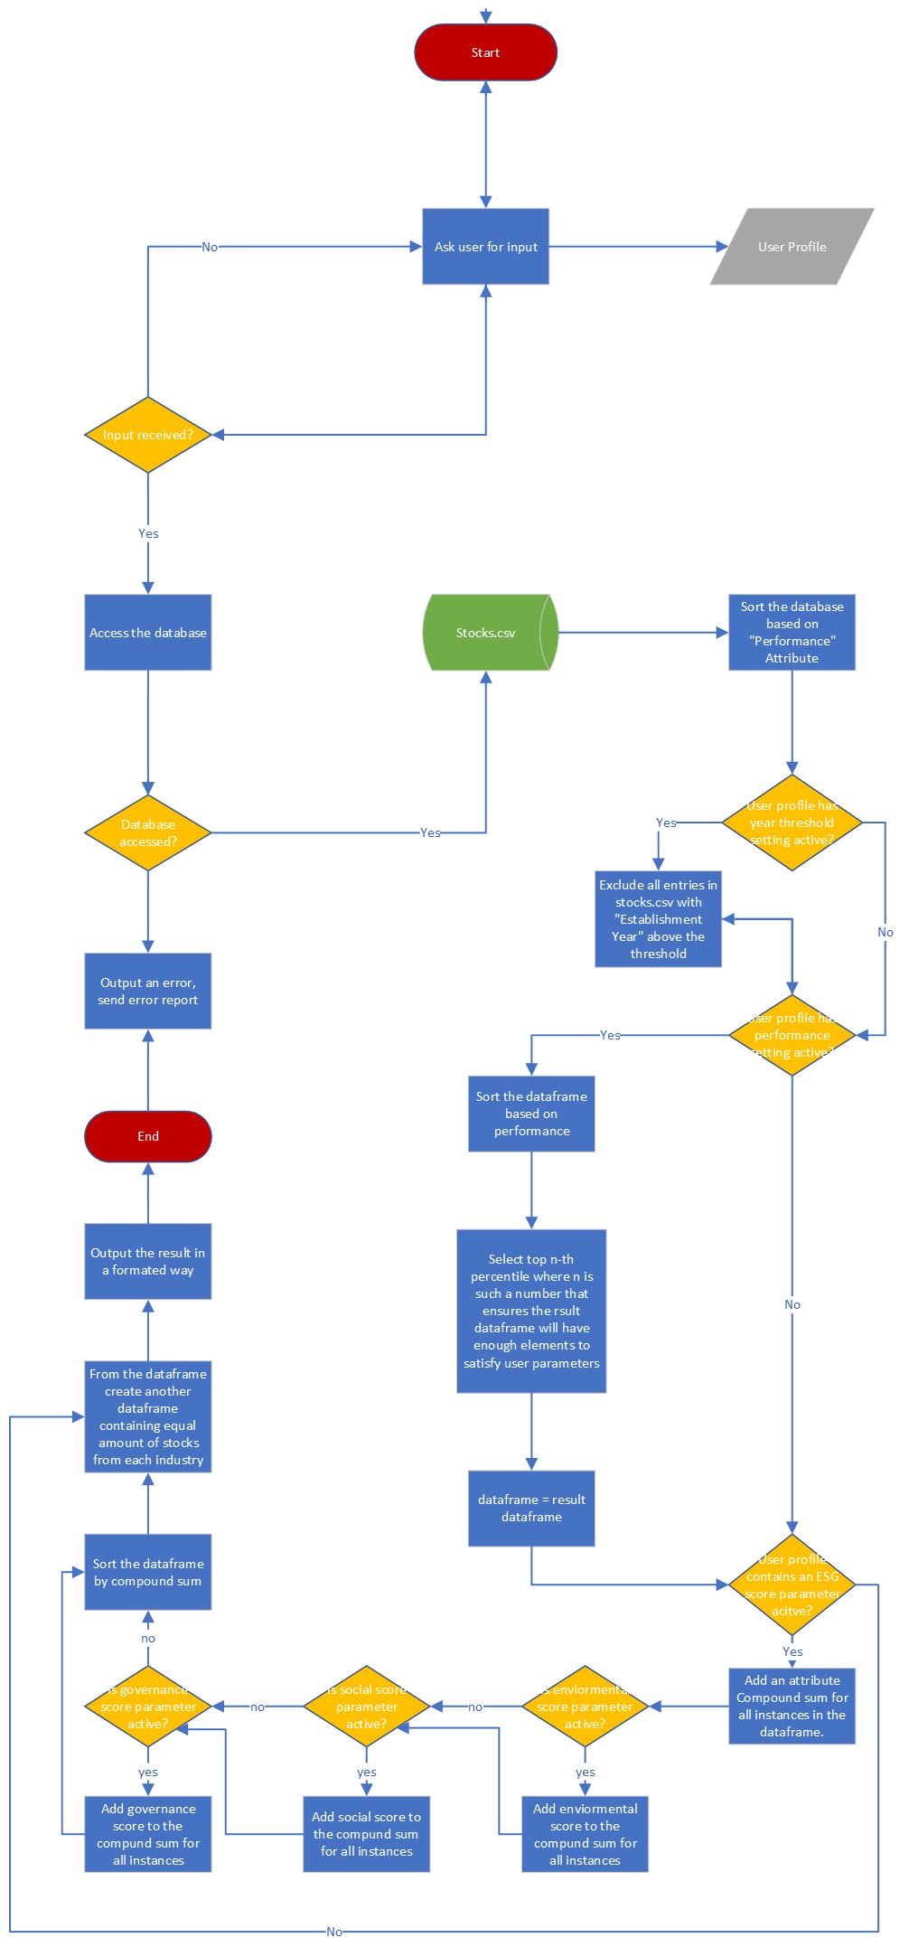

How does itRADE work?
First the algorythms gets the information about the stocks the user is looking for, for exmaple year of establishment, industry, ESG criterias.
Then the algorythm proceses the information in the following order:
Filters for year of establishment
For the top percentile in the industries
ESG criteria
Gives and output if a form of a lovely table

Slide 9
Argumentation for how project works
Year of establishment is the most limiting factor as it limits the amount of stocks the most
Then I also want the beginner user to choose from the best stocks avaible, so the algorythm evaluates the stocks on its performance and select the top performers from each industry.
It is done in such a way, because if the begginer would be discouraged from going into the stock market again if they fail. So instead I am going to ensure the user has the highest chance to succeed with stock he selects later.
And the algoryth prioritizes ESG criterias last and only if the user asked for it to be prioritized, as this criteria is not directly linked to the stocks performance in the market.

Slide 10
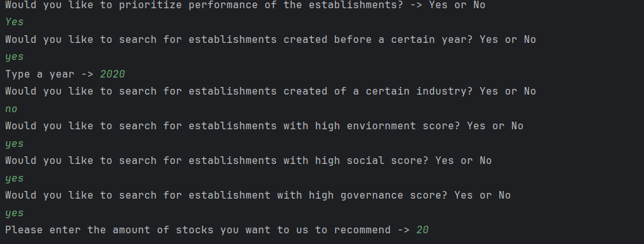
Example Input

Slide 11
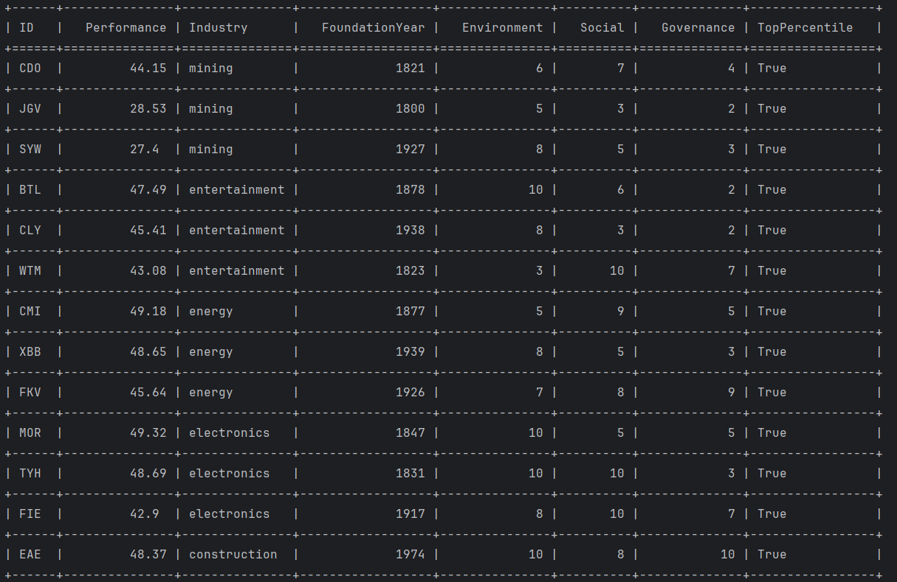
Example output

Slide 12
Final Review & takeaways​
You can check the project out on my Git Hub repository:
https://github.com/Dordeo/ITrade: University project
Are there any question?

Slide 13
THANK YOU
Mykhailo Varha

